Slide 1
Big Mountain Ski Resort Price Report Analysis
Presented by: Parul Rana
Date: March/2023

Slide 2
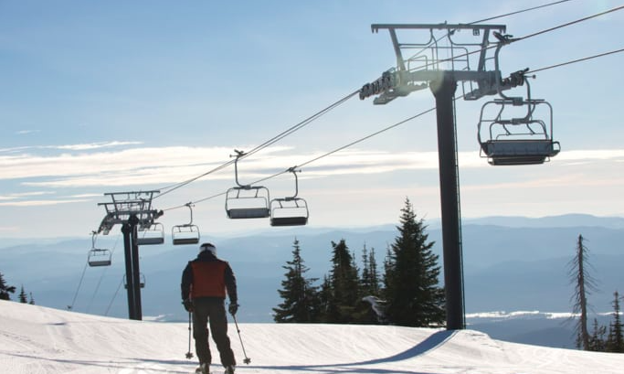
Big Mountain Resort installed an additional chair lift to help increase the distribution of visitors across the mountain. This additional chair increase their ticket revenue by $1,506,5471 this season.
Problems:
The Big Mountain Ski Resort Montana to maximize the revenue and maintain its annual profit
The business profit margin is 9.2% and the investor would like to keep it there.
Investors want to know what to expect for this year revenue if they make any change.

Slide 3
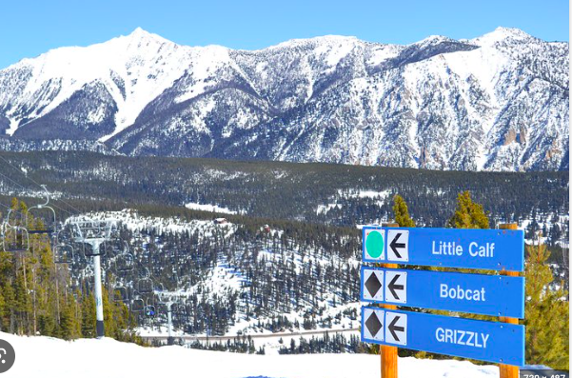
Current Resort’s Pricing Strategy For Big Mountain Resort to base their pricing mainly on just the market average won’t be enough to maximize their revenue and also will not be enough to sustain among other competitors.
Key Findings:
Initial price was $81.00 and modeling price is $ 95.87.
Strong correlation with the ticket pricing are: Runs, SnowMaking, fastQuads, Night sking ratio.
Montana resort comes in 3rd in term of size and has the similar level of facilities.

Slide 4
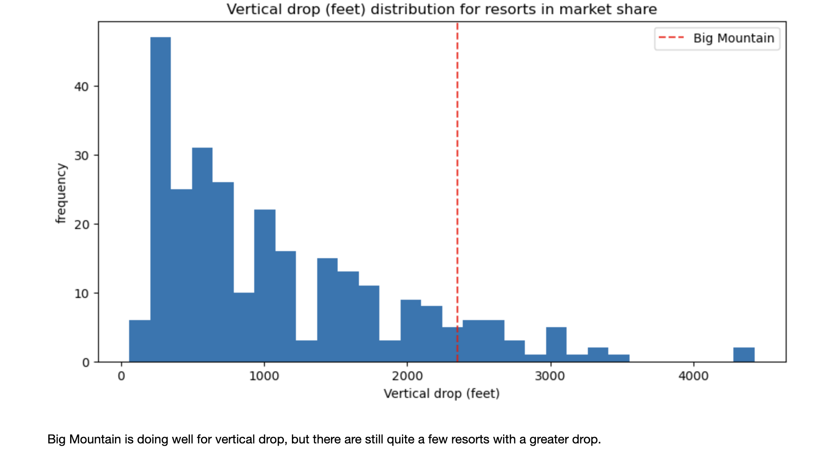
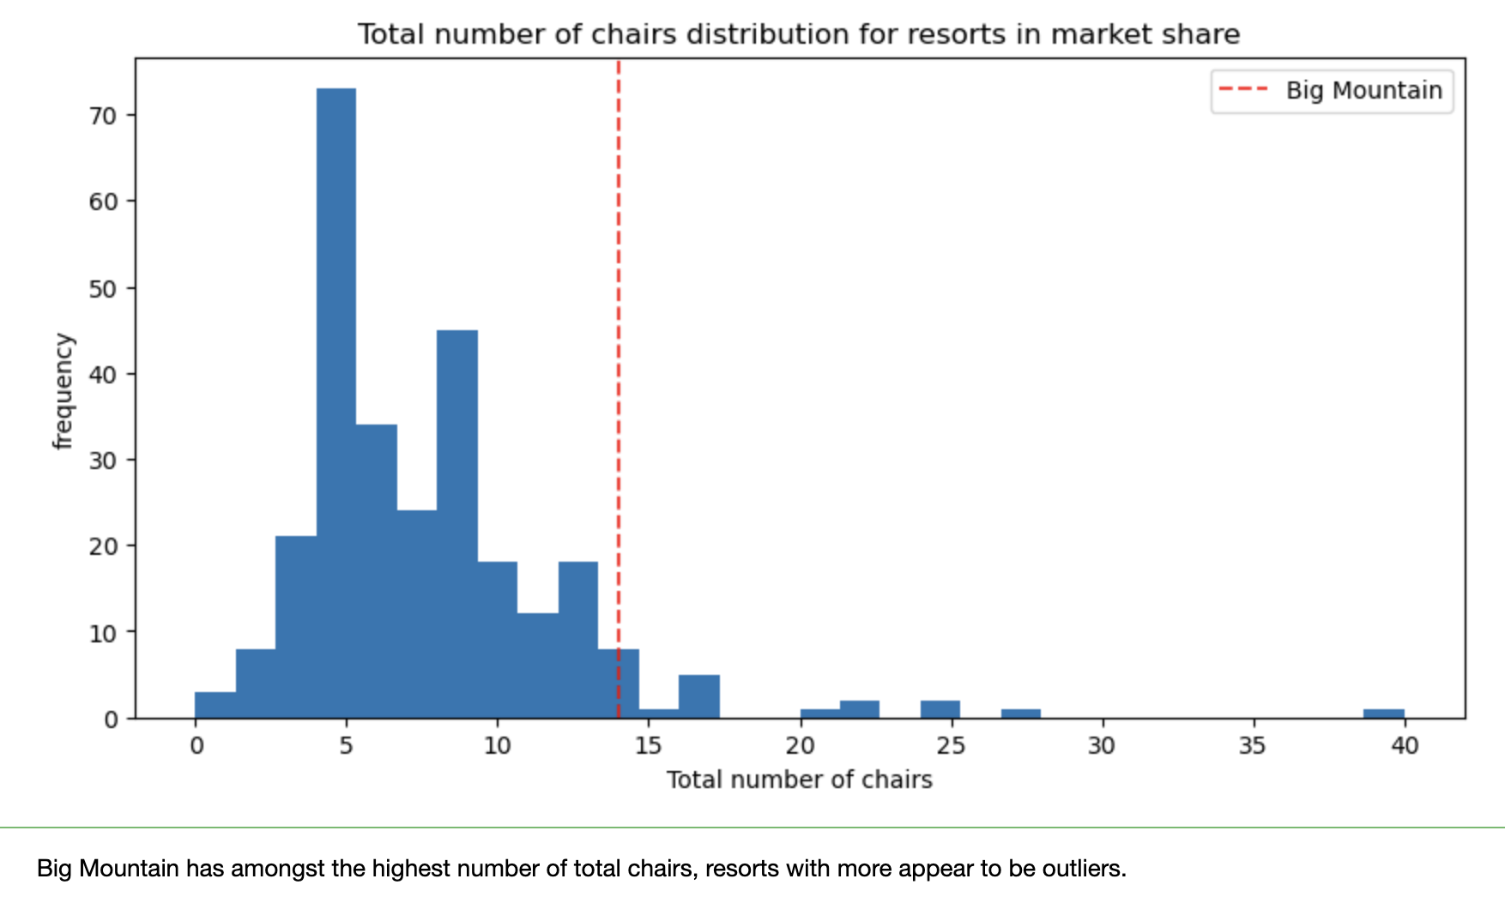
Big Mountain is doing well for vertical drop but there are still quite a few resorts with a greater drops.
Big Mountain has highest number of total chairs, resorts with more appear to be outliers.

Slide 5
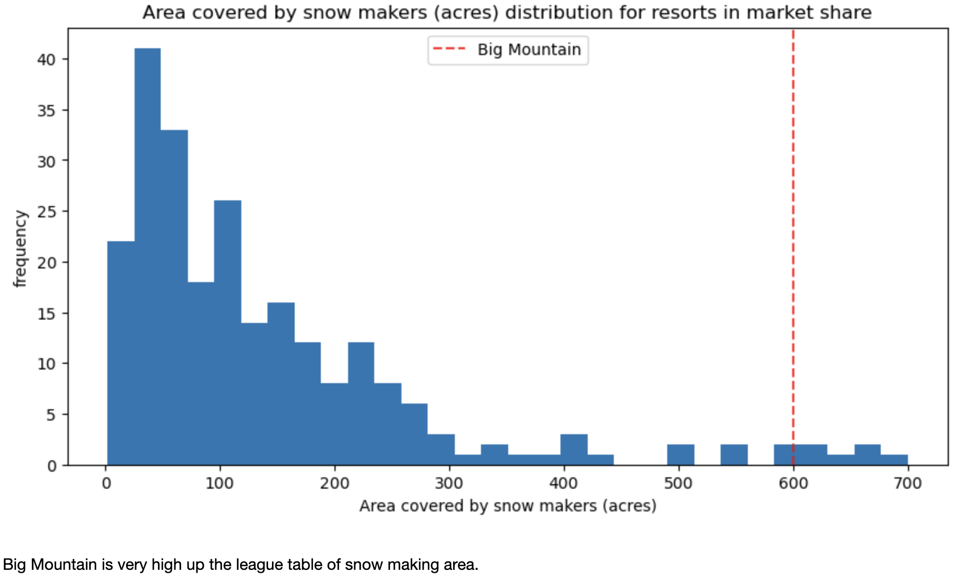
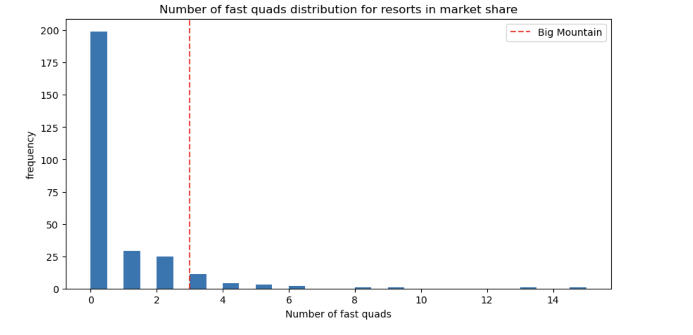
Big Mountain is very high up the league table of snow making area.
Most resorts have no fast quads. Big Mountain has 3, which puts it high up that league table. There are some values much higher, but they are rare.

Slide 6
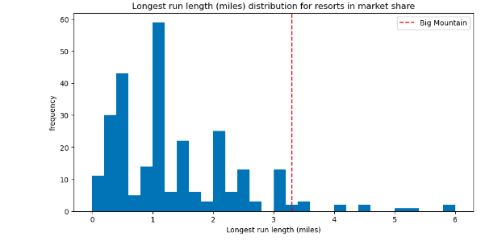
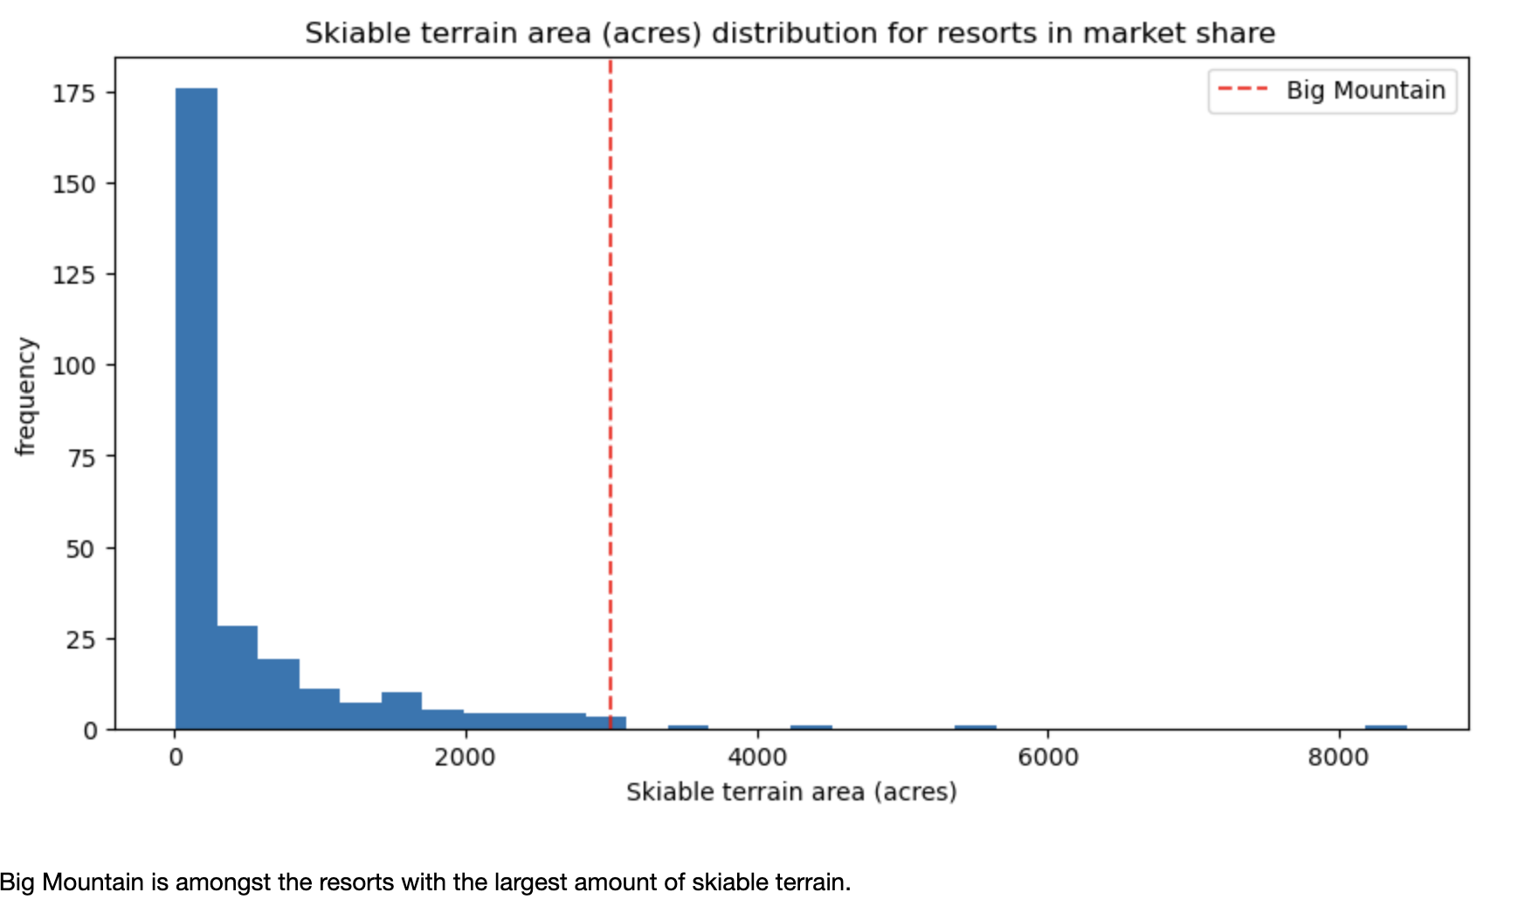
Big Mountain has one of the longest runs. Although it is just over half the length of the longest, the longer ones are rare.
The vast majority of resorts, such as Big Mountain, have no trams

Slide 7
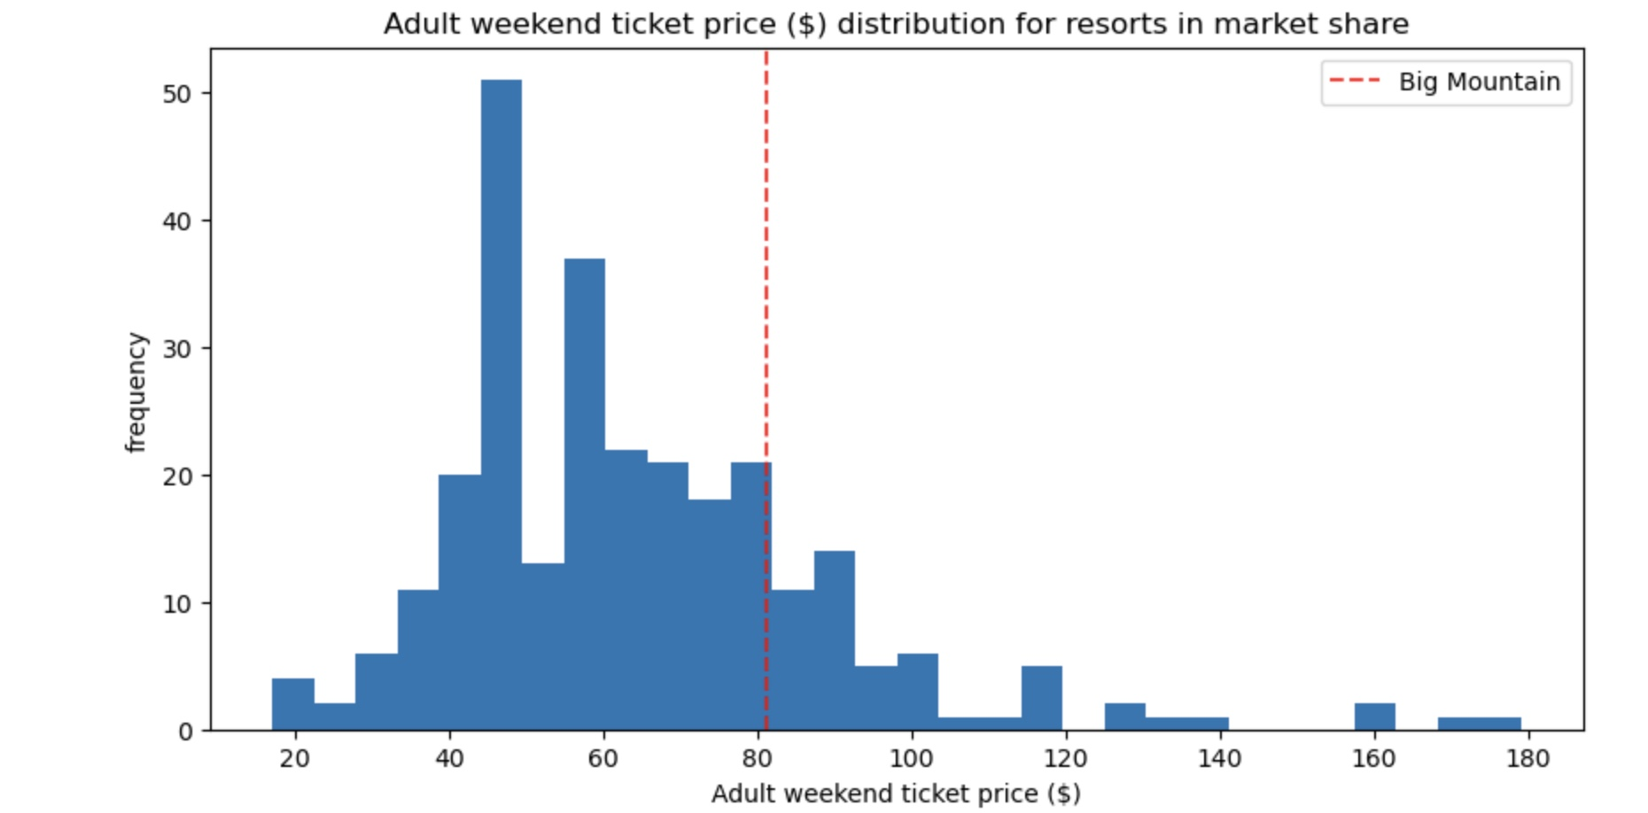
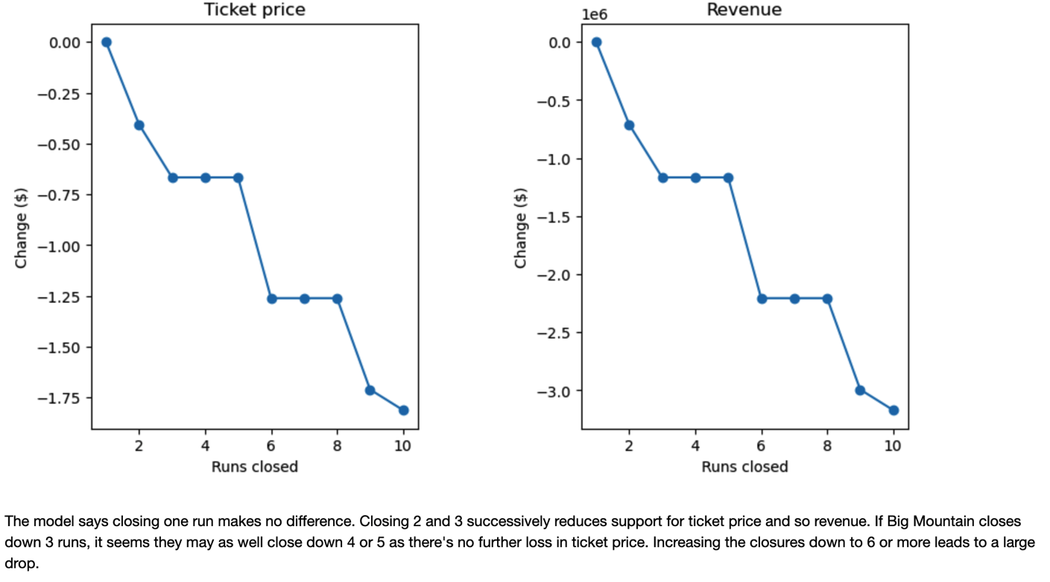
Big Mountain resort current price and revenue: Closing 10 runs reduce support for ticket price and so revenue by $1.71 and $3M respectively
The resort can close up to 6 runs each day without a large drop in revenue
Big Mountain price compared to other resorts.

Slide 8
Recommendations:
Our Model suggests that Big Mountain Resort’s ticket price is lower than the predicted model by 16.31%, and the resort have many potential scenarios for either cutting costs by closing runs or increasing ticket price by increasing vertical drop, adding acres snow making or increasing the longest run.
Raise ticket prices to $95.87
Increase vertical drop by lowering a run 150ft, Install one additional chair lift, Add, Have 4-5 runs closed each day to save on operation costs one additional run, and increase acres of snow cover by two.
Increasing the vertical drop by 150 ft. would increase the ticket price by 10.44% from $81.00 to $95.87, resulting in revenue increase by $1,506,5471.
Adding 2 acres of snow making would increase the ticket price by 12% from $81 to $90.75, resulting in revenue increase by $17,322,717.

Slide 9
Conclusion
Big Mountain has great amenities for customers to offer and they can have a great revenue by doing some changes in there facilities.
After analyzing and building a model, we come to conclusion that Big Mountain Ski Resort can increase the revenue by Increasing the vertical drop by 150 ft would increase the ticket price by 10.44% from $81 to $97.87, resulting in revenue increase by $1,506,5471 .Adding 2 acres of snow making would increase the ticket price from $81 to $95.87, resulting in revenue increase by $17,322,717.
I believe, with all facilities and few changes can help Big mountain resort sustain there position and stand out really well among other competitors. These changes not only help them to improve revenue and profit but also help them to cut of many operational cost.

Slide 10

Questions?

